Slide 1
Closing Entries Profit or Loss Calculation
Doyle, Chapter 14

Slide 2
Determining Profit or Loss
The Accounting Period assumption says the life of a business is divided into periods of time to enable the calculation of profit.
Profit = Income – Expenses, where income is greater than expenses
A Loss occurs when Expenses are greater than Income
In Australia the accounting period or financial year is usually from 1 July to 30 June the following year

Slide 3
Income Statement Accounts
Income and expense accounts must be cleared to zero at the end of each period to determine the profit or loss for the period.
These are called Closing Entries.
Income and expense accounts then begin the next accounting period with a zero balance.
The Profit or Loss Summary account is used to calculate profit.
→ Note: Asset and Liability accounts DO NOT get closed off.

Slide 4
Account Balances after the Closing process…
All Income accounts have nil balances
All Expense accounts have nil balances
The Drawings account has a nil balance
The Capital account has been
increased by the profit → Credit Entry
or
decreased by the loss → Debit Entry
and
decreased by the drawings → Debit Entry

Slide 5
The problem when there are NO closing entries…
Year 1 Year 2 Year 3
Income = 2,000 2,000 + 5,000 = 7,000 7,000 + 8,000 = 15,000
Expenses= 800 800 + 700 = 1,500 1,500 + 900 = 2,400
Profit = 1,200 Profit = 5,500 Profit =12,600
AS CAN BE SEEN FROM THE ABOVE WHEN INCOME AND EXPENSE ACCOUNTS ARE NOT CLOSED OFF EACH PERIOD, THE PROFIT/LOSS WILL GET BIGGER AND BIGGER… THEN WE CANNOT MAKE ANY COMPARISON FROM ONE YEAR TO THE NEXT
Notes:
The point of this example is to show that if revenues and expenses are not closed off at the end of each period then the profit calculations are going to be distorted (i.e. they will include revenues earned and expenses incurred in previous periods).

Slide 6
The solution… Closing Entries !!
At the end of each accounting period the balances within the Income and Expense accounts must be “closed off”.
“Closing off the accounts” means:
Income and Expense accounts are closed off to a zero balance on the last day of the financial year, so that a business can have a “fresh start” for its operations in the new year.

Slide 7
Problem Solved
Year 1 Year 2 Year 3
Income= 2,000 0 + 5,000 = 5,000 0 + 8,000 = 8,000
Expenses = 800 0 + 700 = 700 0 + 900 = 900
Profit = 1,200 Profit = 4,300 Profit = 7,100
Note how the Income and Expense accounts each period start at zero
Income and Expense accounts are closed off to ensure that only Income earned and Expenses incurred within an accounting period are included within the income statement for that period.

Slide 8
Closing Entries: The 4 Steps
Close off Income accounts to Profit and Loss Summary account
Close off Expense accounts to Profit and Loss Summary account
Transfer the Profit or Loss from the Profit and Loss account to the Capital account.
Close off the Drawings account to the Capital account

Slide 9
1. Close off Income accounts to Profit & Loss Summary account
Dr Sales / Fees
Interest income
Rent income
Discount received
Cr Profit & Loss Summary

Slide 10
2. Close off Expense accounts to Profit & Loss Summary account
Dr Profit & Loss Summary
Cr Cost of sales
Wages
Stationery expense
Interest expense
Telephone
Rent expense

Slide 11
3. Transfer profit or loss from Profit & Loss Summary account to Capital account
Dr Profit & Loss Summary (if a profit)
Cr Capital
or
Dr Capital
Cr Profit & Loss Summary (if a loss)

Slide 12
4. Transfer Drawings to Capital account
Dr Capital
Cr Drawings

Slide 13
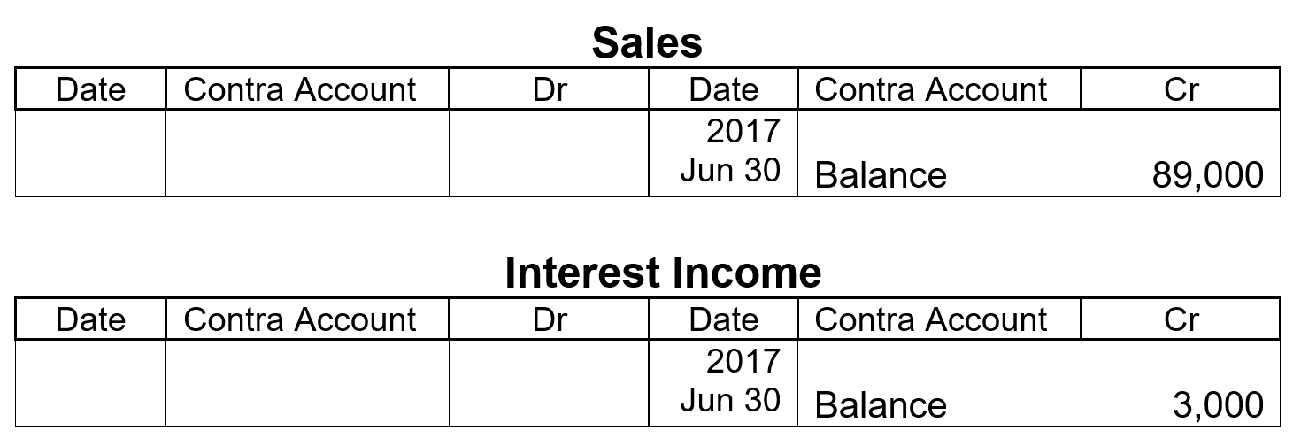
Closing INCOME accounts
P237 – Business Traders Trial Balance
Two types of Income for the year:
Sales $89,000 and Interest Income $3,000

Slide 14
Closing INCOME Accounts
The Sales Account has a Credit Balance of $89,000. To clear the account to a Balance of nil, the Sales account must be debited with $89,000.
The Interest Income account has a Credit Balance of $3,000. To clear the account to a Balance of nil, the Interest Income account must be debited with $3,000.
At the same time the Profit and Loss Summary account must be credited by $92,000 ($89,000 plus $3,000).
Income accounts have Credit balances. To clear an income account, we would therefor DEBIT the account with the same amount as the Credit balance, in order to get it to a nil balance.

Slide 15
Closing Income Accounts → General Journal Entry
 | Debit | Credit
Sales Interest Income | 89,000 3,000
Profit & Loss Summary |  | 92,000
Close off Income accounts

Slide 16
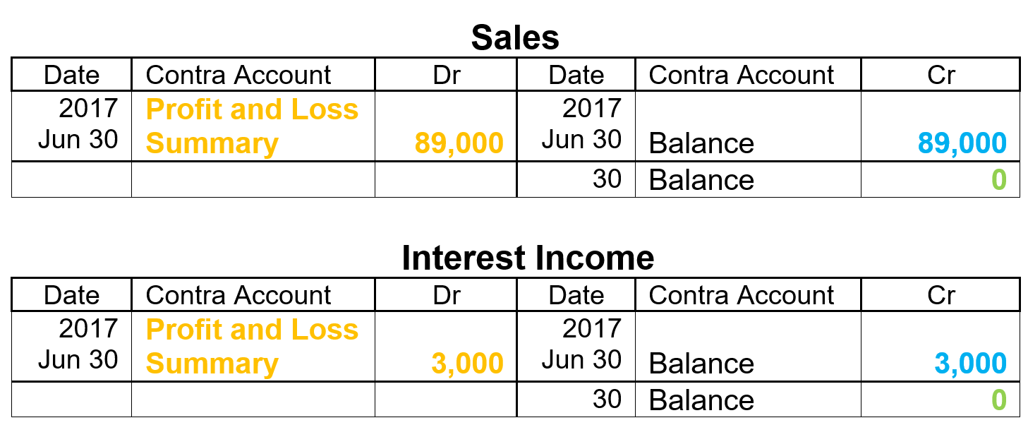
Income accounts in the General Ledger after the closing entries p238
Sales accumulated for the Financial Year amounts to $89,000.
Interest Income amounts to $3,000.
These Income accounts get closed off to the Profit and Loss Summary account.
The Balances of the Sales and Income accounts are now both nil.

Slide 17
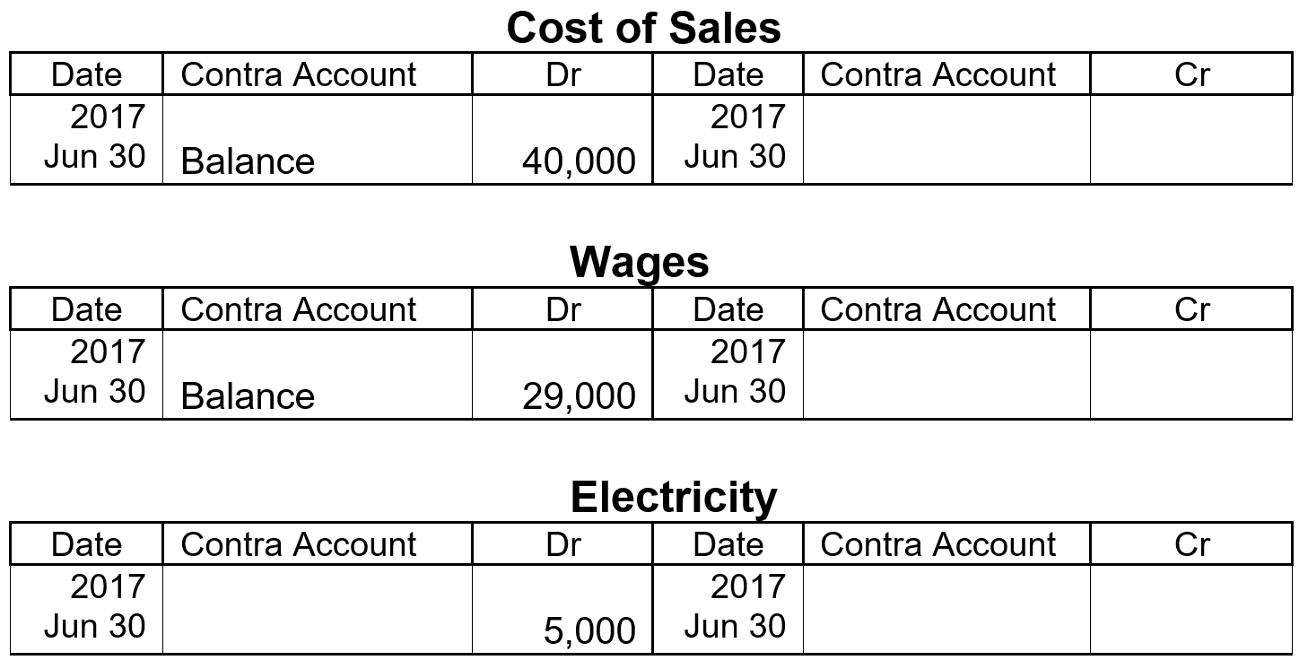
Closing Expense Accounts
From the Trial Balance: Cost of Sales $40,000 Wages $29,000
Electricity $ 5,000

Slide 18
Closing Expense Accounts - General Journal Entry
 | Debit | Credit
Profit and Loss Summary | 74,000
Cost of Sales Wages Electricity |  | 40,000 29,000 5,000
Close off expense accounts
Expense accounts have Debit balances. To clear an expense account, we would therefor CREDIT the account with the same amount as the Debit balance, in order to get it to a nil balance.

Slide 19
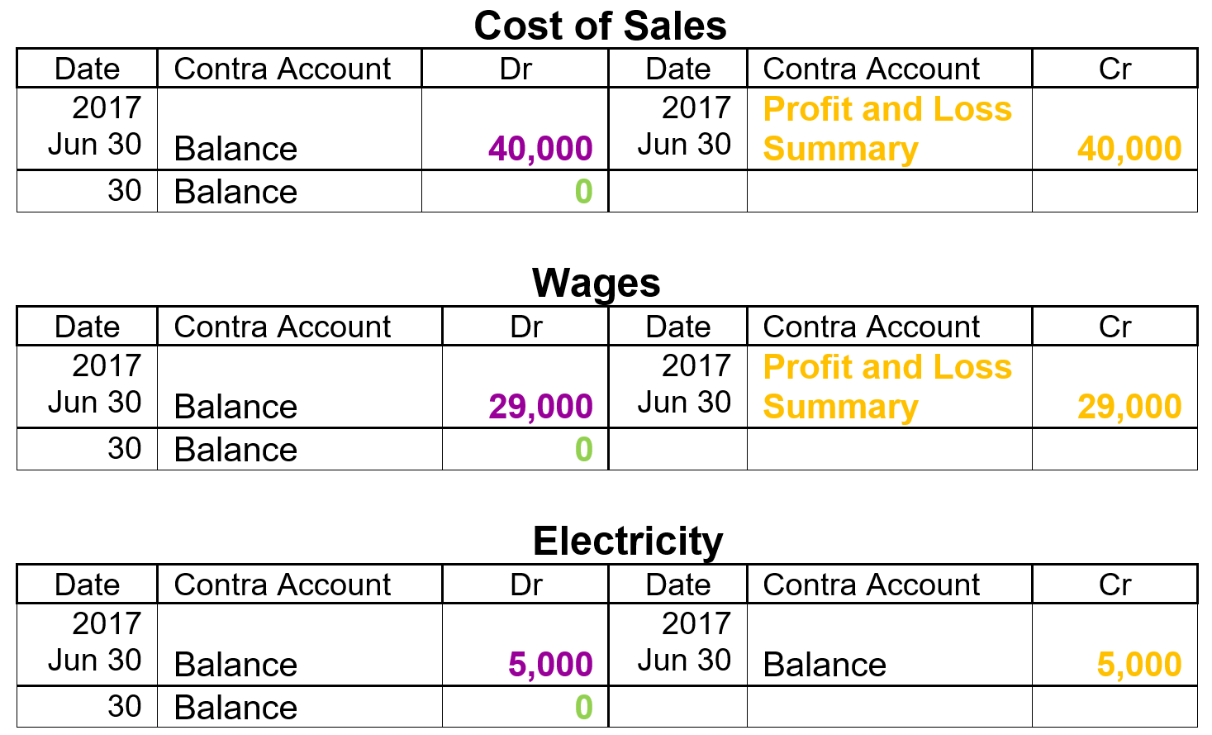
Expense accounts in the General Ledger after the closing entry
The Expense accounts get closed off to the Profit and Loss Summary account.
The Balance of each of the Expense accounts are now nil.

Slide 20
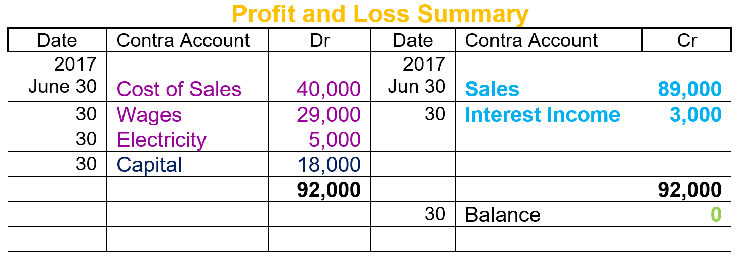
General Ledger: - Profit and Loss Summary Account
In the above Profit and Loss Summary account the total credits are more than the total debits, which results into a CREDIT BALANCE, and therefor the business has made a PROFIT of $18,000… this profit needs to be transferred to the Capital account.
In a different case where there are more debits than credits, it would result into a Debit balance, and therefor a Loss, which would also be transferred to the Capital account.

Slide 21
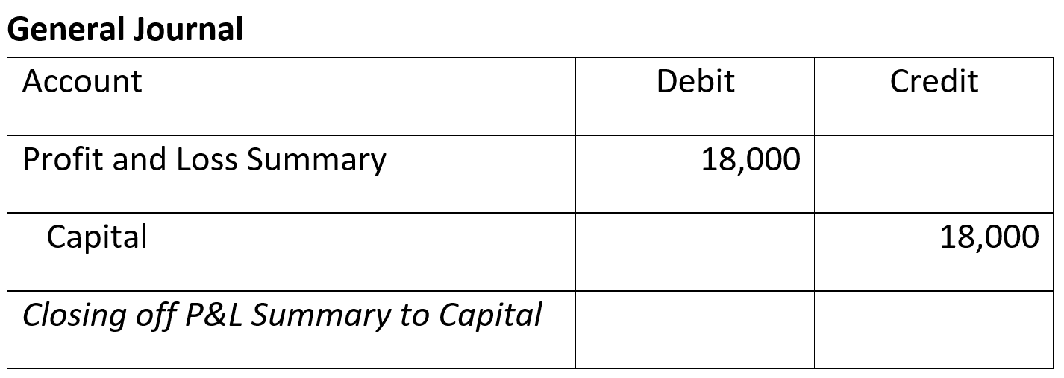
Closing the Profit and Loss Summary acc
Business Traders has made a $18,000 profit ($92,000 Income – $74,000 Expenses).
The P&L Summary will therefore have a $18,000 credit balance.
This needs to be closed off to the Capital by debiting the P&L Summary account and crediting the Capital account.

Slide 22
Closing the Profit and Loss Summary acc
The P&L Summary is a temporary account that only gets used on the last day of the Financial Year, i.e. 30 June.
It then gets closed off to the Capital account.
The closing balance in the P&L Summary account represents the profit or loss for the period.

Slide 23
Closing off the Drawings account
The Drawings account has a $9,000 Debit balance which must be closed off to the Capital account.
Drawings is almost like an Equity Expense account and therefore needs to be closed off at financial year end.
The entry in the General Journal would be as shown below:
 | Debit | Credit
Capital | 9,000
Drawings |  | 9,000
Close off Drawings to Capital

Slide 24
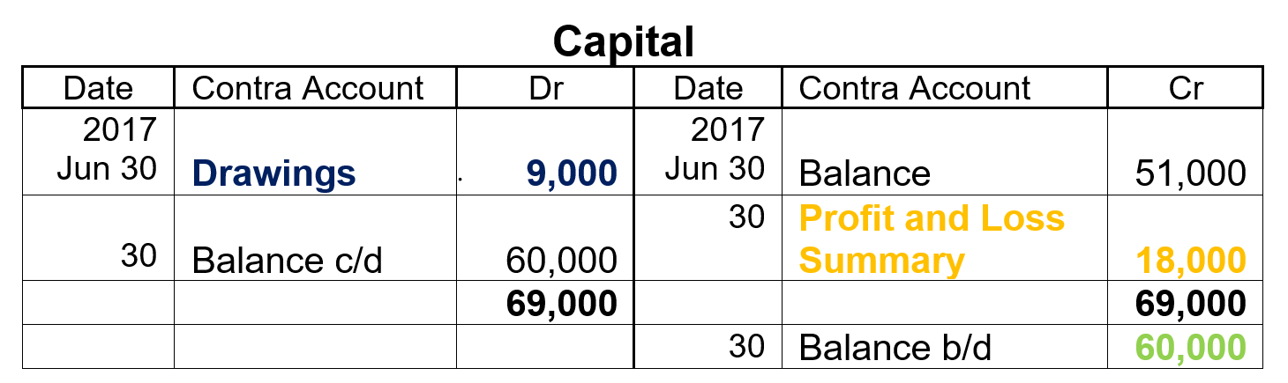
General Ledger: - Capital account after closing entries
Prior to the Closing Entries, the Capital account had a Credit balance of $51,000.
After the Closing Entries a PROFIT of $18,000 was determined.
Earlier in the year we learned that a profit is the owner’s award for making good business decisions… therefor Owner’s Equity increases in the Capital account.
The Capital Account was credited with the profit of $18,000 and debited with the Drawings of $9,000.
The result is a new balance of $60,000.

